Slide 1



Prepped To Change
Toward Healing Organizations

Slide 2
Influencers
National
Ken Hardy, Healing the Wounds of Racial Trauma
Alicia Lieberman, Patricia Van Horn, Chandra Gosh Ippen, Child Parent Psychotherapy
Anda & Fellitti, ACEs Study
Sandra Bloom, The Sanctuary Model
Maine, THRIVE Initiative
Local
Joyce Dorado & Lynn Dolce, HEARTS Program
Lena Miller, D10 Trauma Summit Report
Tomas Aragon, Calculating Expected Years of Life Lost to Rank the Leading Causes of Premature Death in San Francisco
Melanie Tervalon, Cultural Humility vs. Cultural Competency
Notes:
Shameless Stealing Relentless Sharing

Slide 3






Trauma
Informed?
Trauma Informed
Systems?
Trauma
Responsive?
Trauma Informed
Practices?
Trauma Informed Communities?
ACES?
ACES
Connection?
Secondary
Trauma ?

Slide 4

Trauma Informed Systems principles and practices support reflection in place of reaction, curiosity in lieu of numbing, self-care instead of self-sacrifice and collective impact rather than siloed structures.”
- Epstein, K, Speziale, K, Gerber, & Loomis, B (2014): SF DPH TIS (Trauma-Informed Systems Initiative
Connecting communities to compassionate systems. Reclaiming Bay Area futures.

Slide 5
Relational Leadership
“I've learned that people will forget what you said, people will forget what you did, but people will never forget how you made them feel.”
Maya Angelou
Notes:
Who AM I

Slide 6
PREPPED To Change
Planning: Listening/Incorporating
Reflection: Thinking and Mindful
Education: Knowledge/Information
Perspective: Shared Understanding
Problem Solving: Engaged
Equity: Social Justice
Deliberate: Strategic Decisions.
Notes:
Bureaucracies are inhumane it takes intentional leadership to make them humane.
(P)Being Understood, (R) Building a thinking/Mindful organization, (E)Common Principles,(P) Differences, (P)engaged, invested, Inclusive Solutions, (E) Policy Based on Need, (D) Data Informed Decision.

Slide 7
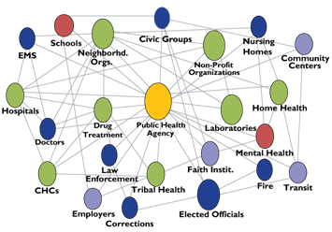
HISTORY: STRESS AND TRAUMA ARE PUBLIC HEALTH ISSUES
Stress linked to 6 leading causes of death
Heart disease, cancer, lung ailments, accidents, cirrhosis of the liver, and suicide
Trauma impacts more than just the individual
Ripple effect to others
Some communities disproportionately affected
Racism + Urban Poverty + Trauma = Toxic
Intergenerational transmission of trauma
Systemic, preventative approach needed
Notes:
A public health issue is big!
This is a huge call to action and requires us to lead differently—work differently—think differently—and act differenly
Change can also be a stressor—as can calls to action
Workforce needs safe spaces – especially those in leadership roles as they usually don’t have these this type of refuge to think with their peers and be honest about challenges – have reflective moments to integrate learning and focus on growth.
We will experiment in builiding one today and see how it goes..

Slide 8
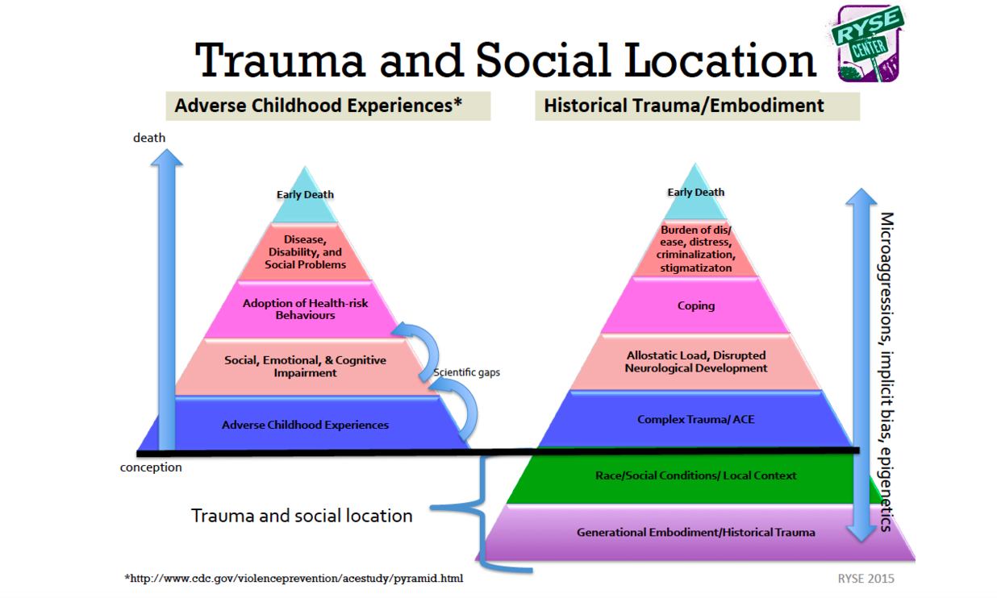
ACE STUDY: BACKGROUND
Notes:
Trauma is historical, intergenerational, institutional, structural and so healing must also be…Linked to too many poor health outcomes for individuals and communities
Brief Overview—highlight that it study recreated with lots of populations with more or less same results and continues to this day—Acesconnection.com CDC website—built into many tools so that Systems of Care can collect--

Slide 9
Historical Trauma
“A society that cannot remember its past and honor it is in peril of losing its spirit.”
Vine Deloria Jr.

Slide 10
Community Impact of Racism
Historical Unresolved Grief
Disenfranchised Grief
Internalized Oppression

Slide 11

GOVERNMENT
THE PUBLIC
FUNDERS
ORGANIZATION
ADMINISTRATION
STAFF
Trauma affects organizations and systems as well as communities and individuals
CLIENT
Notes:
We get hurt in relationships, we heal in relationships.
Symptoms of trauma live in individuals as well as our workforce (Walden House example), in our leadership (checked out/reactive/hypervigilant/defended), organizationally, and even in our funding streams—silo, us/them, mine/yours, territorial, etc
Shout out for the principles as a path back from this kind of suffering at all levels

Slide 12
A Traumatized System
Reliving/Retelling
Increased Arousal/Reactivity
Avoiding

Slide 13
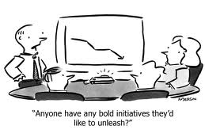
Initiatives

Slide 14

Technology and Paperwork demands
Lawsuits, reforms, task-driven vs. relational
Client needs vs. HMO models of care
Feeling unsafe with students
Staff and Budget Cuts!!!
Staff Turnover
Not enough time for collaboration or supervision
Traumatic events-violence, suicide, deaths
Trauma-Organized Systems: Chronic Stressors and Collective Trauma
Notes:
Bloom Article: chronic stressors can lead to following symptoms or organization: loss of safety, lack of emotional management, disassociation, amnesia, fragmentation—broken feedback loops, increased authoritarianism, disempowerment, breakdown of communciation, inability to resolve conflict, demoralization…in short, a trauma-organized system.

Slide 15


THE PUBLIC
GOVERNMENT
FUNDERS
ORGANIZATION
ADMINISTRATION
STAFF
CLIENT
TRAUMA ORGANIZED
TRAUMA INFORMED
HEALING ORGANIZATION
Reactive/Organizational Hyperarousal (Crisis driven)
Reliving/Retelling
Fragmentation/Us vs Them
Interpersonal Conflict/Silo
Organizational Disassociation/Amnesia
Avoiding/Numbing
Authoritarian Leadership
Reflective
Collaborative
Culture of learning/Curiosity
Making meaning out of
the past
Growth and Prevention Oriented (Conflict OK)
Relational Leadership
Shared Language
Foundational Understanding of Trauma and Healing
Understanding of the nature and impact of trauma
Understanding racial disparities and insidious trauma
TRAUMA INDUCING
TO
TRAUMA REDUCING
Notes:
We know…where we are...where are we headed? What does it look like?
Begin to think about Blooms theory of parallel process of recovery---individual recovery, organizational recovery and Systemic healing..
Examples from each.
Truama Organized: Death of teacher at TNS; van at Walden, CBOs competing and not connecting, closed doors—”we dont fund this, you have to go here”, ---we are learning, insert TIS Plug here but need to sustain learning and practices with orgnaizational structures that support healing relationships.

Slide 16
Trauma Understanding
Trust & Dependability
Comprehensive
Safety
System & Service
Perspectives
Neurobiology & Development
Cultural Humility & Responsiveness
Collaboration & Empowerment
Resilience & Recovery

Slide 17
Change
“People don’t resist change.
They resist being changed.”
(Senge, 1990)

Slide 18


Innovations do not benefit those who never experience them.
–Fixsen, D

Slide 19
Trauma Informed System:
Conceptual Framework
ORG Leaders
Middle Management
Champions
Evaluation
Leadership Engagement
Training: Trauma 101
Embedded
trainers
Policy and Practice
Jim
Notes:
Weve talked a lot about what we don’t have—lets talk about what we do have A LOT>.
We have methodologies, peer groups, trauma experts and we have systems that developed models for change that created and modeled healthy and supportive relationships in the organizations..

Slide 20
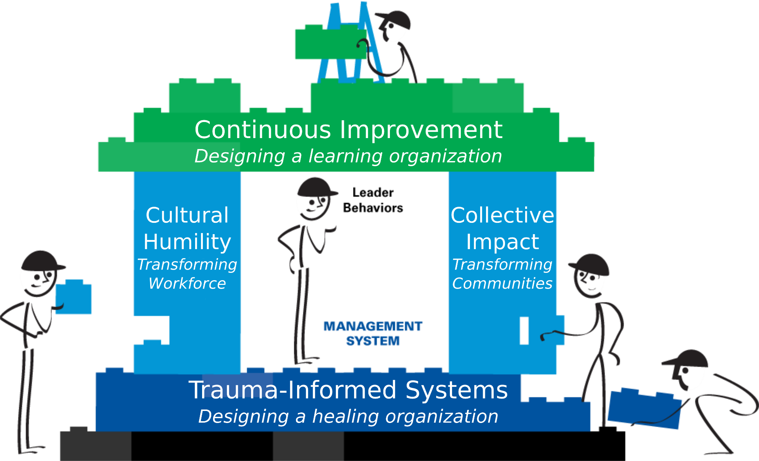
POLICY AND PRACTICE
Notes:
KEN

Slide 21
SF Trauma Informed System Evaluation Plan
System Impacts
Are we improving our system?
Client satisfaction, staff engagement, etc.
Practice Change
Are we creating change?
Individual and program commitments to change
Knowledge Change
Are we supporting learning?
Trauma 101 training evaluations
Notes:
Our evaluation plan takes a multi-layered approach.
Knowledge change: Are we creating a meaningful and motivating learning experience with our Trauma 101 trainings?
Every participant fills out a 2 page training evaluation
Practice change: Are we providing support for transitioning knowledge into actual changes in our workplace? Evaluation components sometimes serve dual purpose of both evaluating change and creating it.
System impact: What do we expect will change over time when we are knowledgeable about and practicing trauma-informed principles?
For example, the recent staff engagement survey. We expect the impact to evolve slowly as trauma informed principles are practiced more frequently at the individual, program, and system level.

Slide 22
Practice: Commitment to Change Project
Commitment to Change tools help shift knowledge into practice.
ALL participants complete C2C
85% will continue implementing change
“one of the best things to ever happen to me” “empowering” “more positive and fun shift”
83% are completely or partially successful with change
Notes:
Commitment to Change is the final step in our Trauma 101 training and in it we ask participants to identify one small trauma informed change that they can make in their worklife.
Participants create a plan to make that change and our evaluation team checks back in with them 1-2 months later to see how they did.
The response and participation has been promising.
Many participants report that they view this project specifically as a sign of SFDPH’s commitment to becoming a trauma informed system because we follow up with them after the training.
Although not all participants are successful, the vast majority are and plan to continue implementing the changes.
Participant quotes:
“It was difficult at first. But as I put it into practice, I felt a sense of relief because it became easier to incorporate it in my attitude and thinking.”
“It worked out fine my team now are working better and are more understanding of each other which eliminates a lot of stress. ”
“It makes coming to work worthwhile. ”

Slide 23
Knowledge:
Support for becoming a Trauma Informed
System
It won't be simple...
Participants agree (3.87), but to a lesser extent, that the TIS principles will be easy to apply
Participants are unsure (2.54) if the initiative will be abandoned or poorly Implemented.
...but I want to help our system
Participants strongly agree (4.59) that the initiative will improve their life.
Participants agree (4.32) that they want to help our system be trauma informed.
Participants disagree (2.5) that SFDPH is already trauma informed.
Participants strongly agree (4.62) that it is important for everyone to be trauma informed.
Mean on a 5pt scale of agreement.
Notes:
Participants’ perspectives on becoming a trauma informed system are measured at the 1-3 months following the training on 5 point scale of “agreement.”
Mean scores
We consistently receive overall approval scores of 4 or higher.
Participants leave the training feeling that it is important to become trauma informed and it will improve their daily worklife.
However, they are unsure if we are committed to the process of becoming a TIS or if this initiative will be unsuccessful and they are not yet confident that they will be able to easily apply the TIS principles in their own work.
These findings tell us that we are able to instill a sense of value for becoming a trauma informed system and that we need to keep the work of becoming a trauma informed system visible and easy to implement.

Slide 24
Impact: All staff engagement survey
The all staff engagement survey allows us to track how key features of a trauma informed system may evolve over time.
Compassion & Dependability
“I have benefitted from a one-on-one relationship with the person I report to.”
“It is obvious to each patient/resident that we are personally concerned for their well-being.”
“When a patient/resident needs help, he or she gets prompt attention.”
Notes:
The all-staff engagement survey will be a useful tool in seeing how efforts, including the TIS Initiative, are impacting our department’s ability to engage staff.
Individuals items from the survey can be mapped onto TIS principles to see progress over time as the survey is administered on an annual basis.
To establish a more direct link to the impact of becoming trauma informed, the all staff engagement survey will be examined at the program level among programs who are TIS champions to track how their adoption of TIS principles impact their staff engagement scores over time.

Slide 25

Cultural humility & Responsiveness
Racial/cultural equity
Practices
Trauma Understanding
TIS 101
Resilience & Recovery
Mindfulness
Organizational Healing
Policy
Evaluation
Compassion & Dependability
Reflective Supervision
Collaboration & Empowerment
Participatory Decision Making
Notes:
Rapid Change Cycles/ what is next

