Slide 1
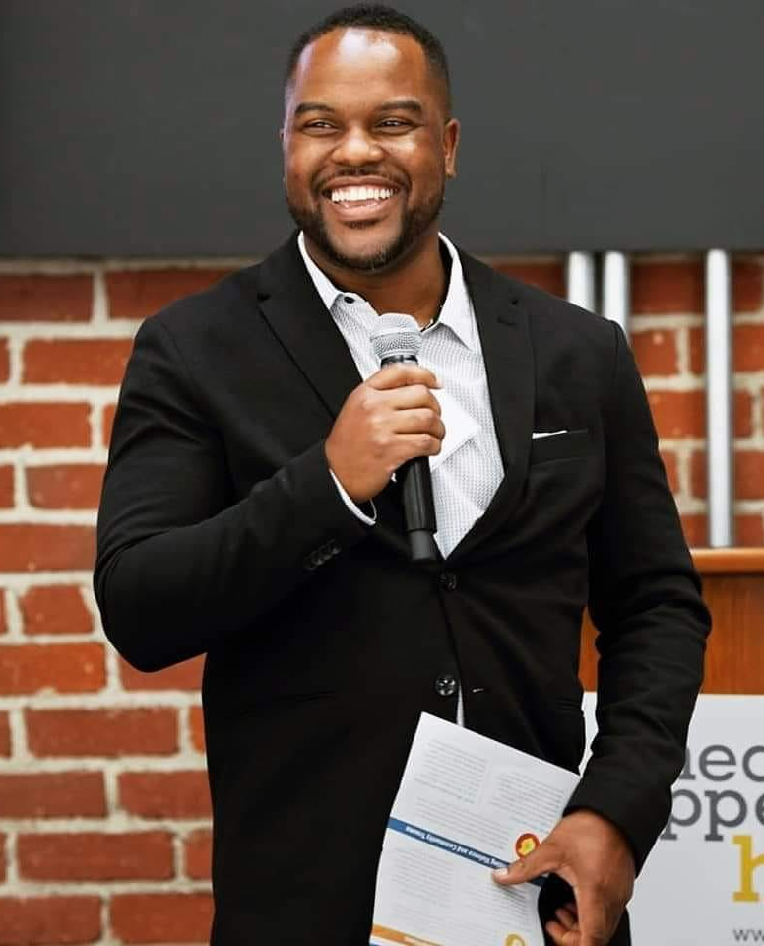
Resilient Sac –Racing ACEs
DeAngelo Mack
Director of State Policy

Slide 2
How does Childhood Adversity Impact Racial Disparities in Adult Health Outcomes

Slide 3
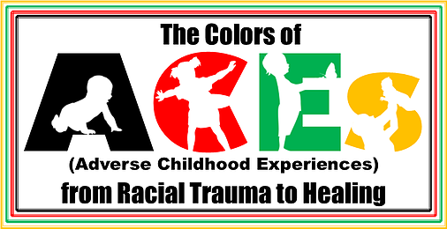
DEFINING RACISM
Personally mediated racism - an acute stressor, including individual insults and discriminatory acts
Cultural racism - determines which group qualities and characteristics are valued/devalued
Internalized racism - acceptance by members of the stigmatized races of negative messages about their own abilities and intrinsic worth
Institutionalized racism - discriminatory, race- or class-based policies and practices (informal and formal)
(adapted from CP Jones AJE 2001;154;299-304)
and Project Change 1999

Slide 4
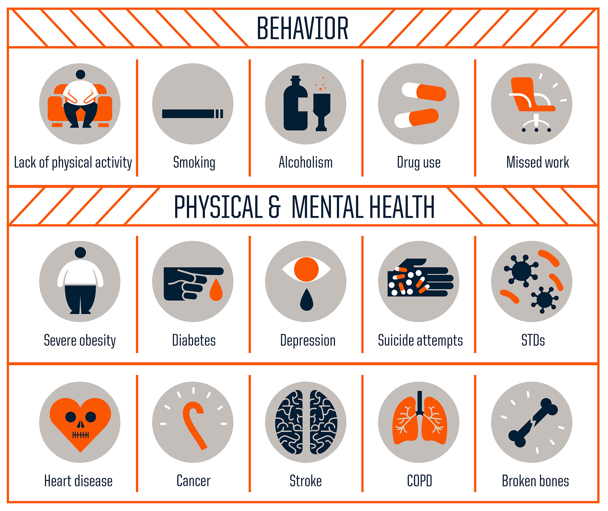
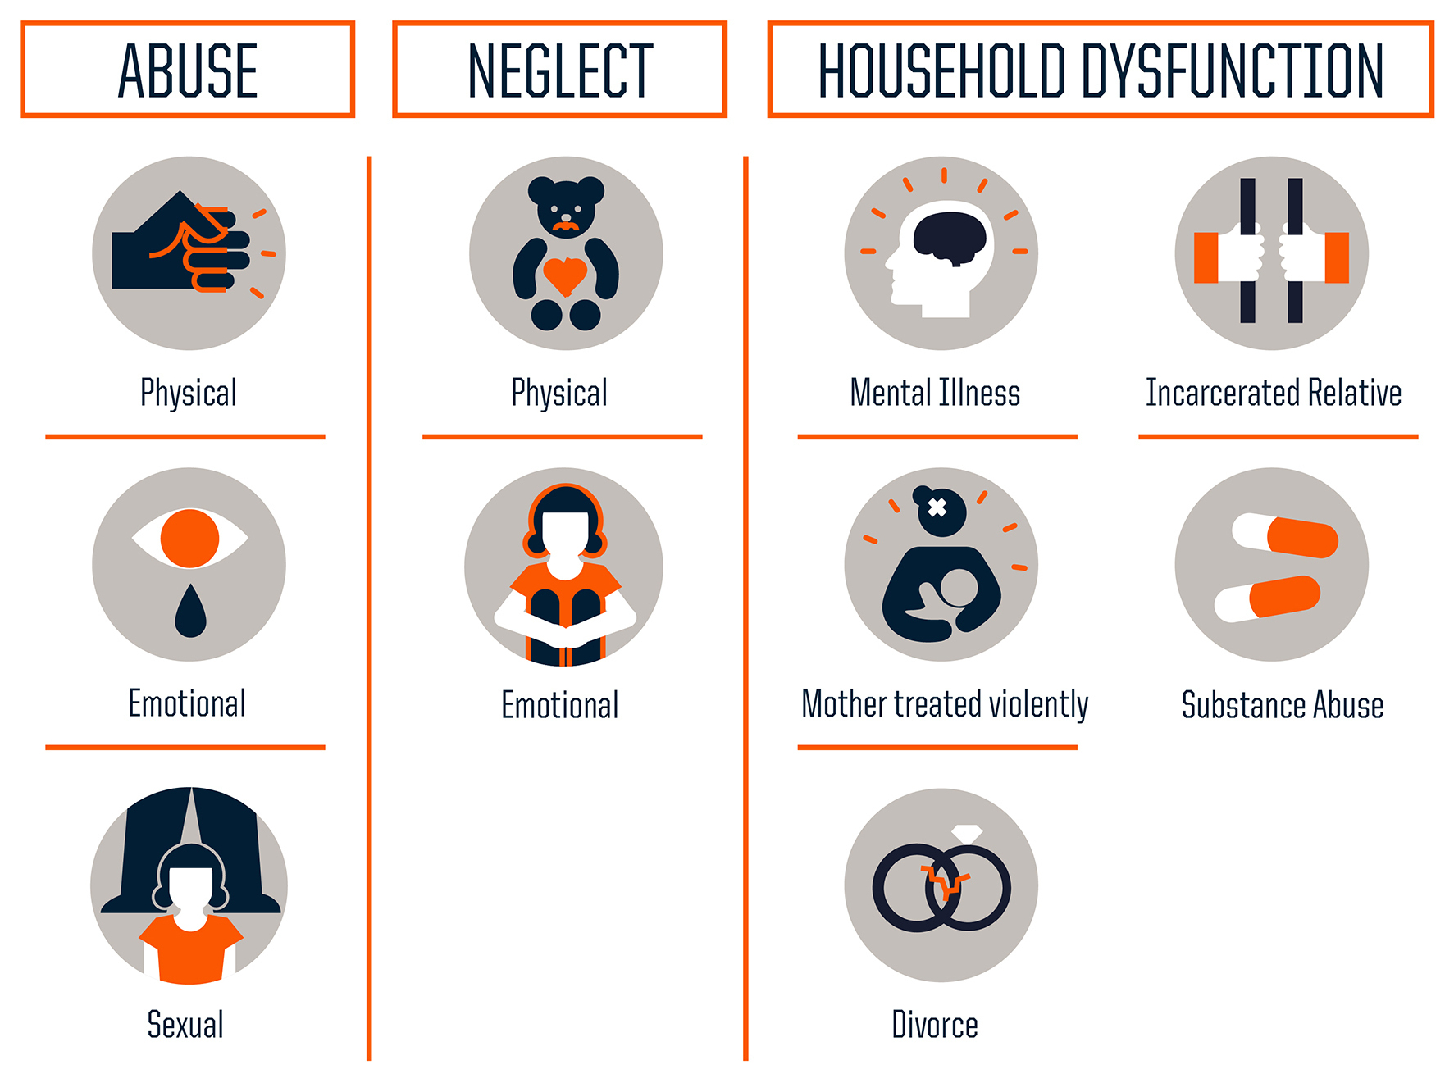
Childhood Trauma
Adverse
CHILDHOOD
Experiences
Notes:
Timing: abuse, neglect and household dysfunction before age 18
The Story:
Accidental finding in obesity clinic with patients of size
Duplicated in 17,000 Kaiser Patients
Perceived low risk: mostly white, college educated, and insured by employer
Since 1997 over 200 publications on short and long-term outcomes

Slide 5

ACEs STUDY POPULATION
Disproportionately
  White
  Employed
  Insured (by Employer)
  College-Educated
  Middle Income

Slide 6
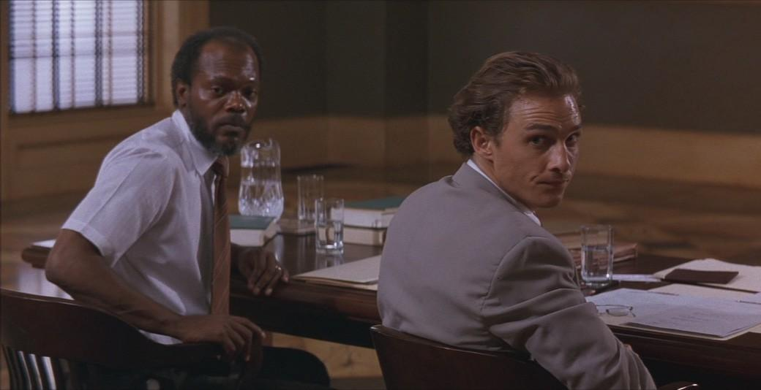
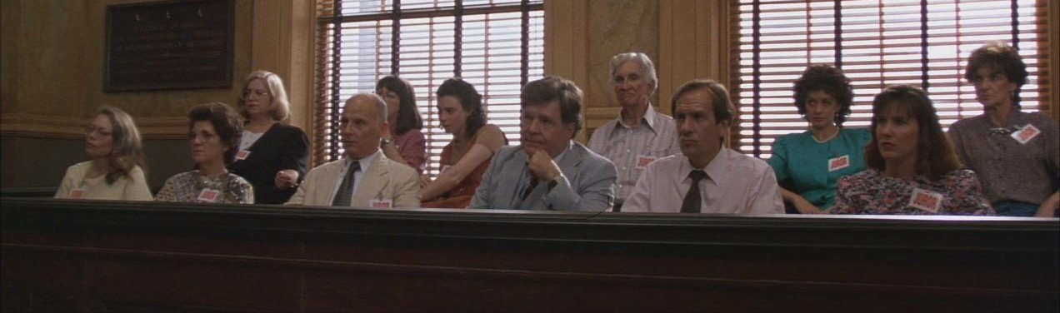
THIS… IS A JURY OF MY PEERS?
Excerpt from “A Time To Kill” – Carl Lee Played by Samuel L Jackson
#ACEsCon2018

Slide 7

WHO IS MISSING?
Black
Latino
Asian/PI
Native American
Immigrant
Medi-Cal
Uninsured
Homeless
Children*
#ACEsCon2018

Slide 8
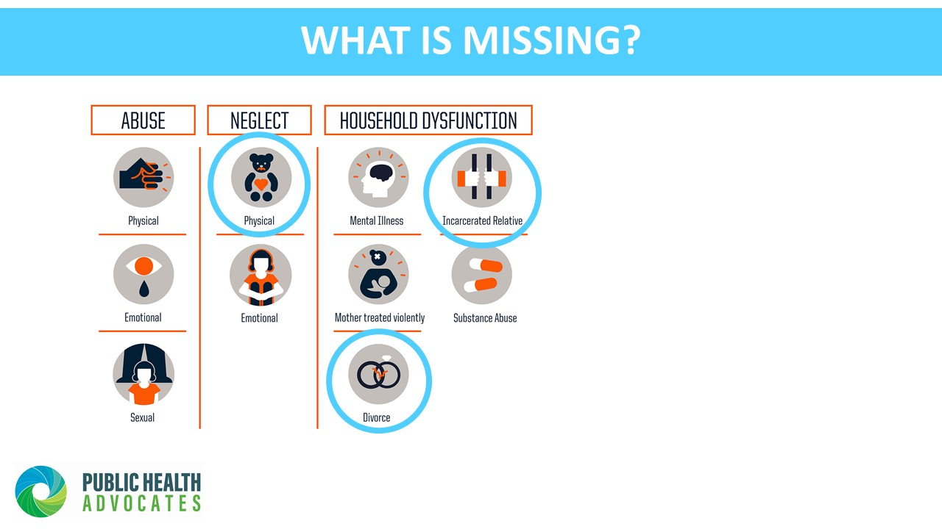

Slide 9
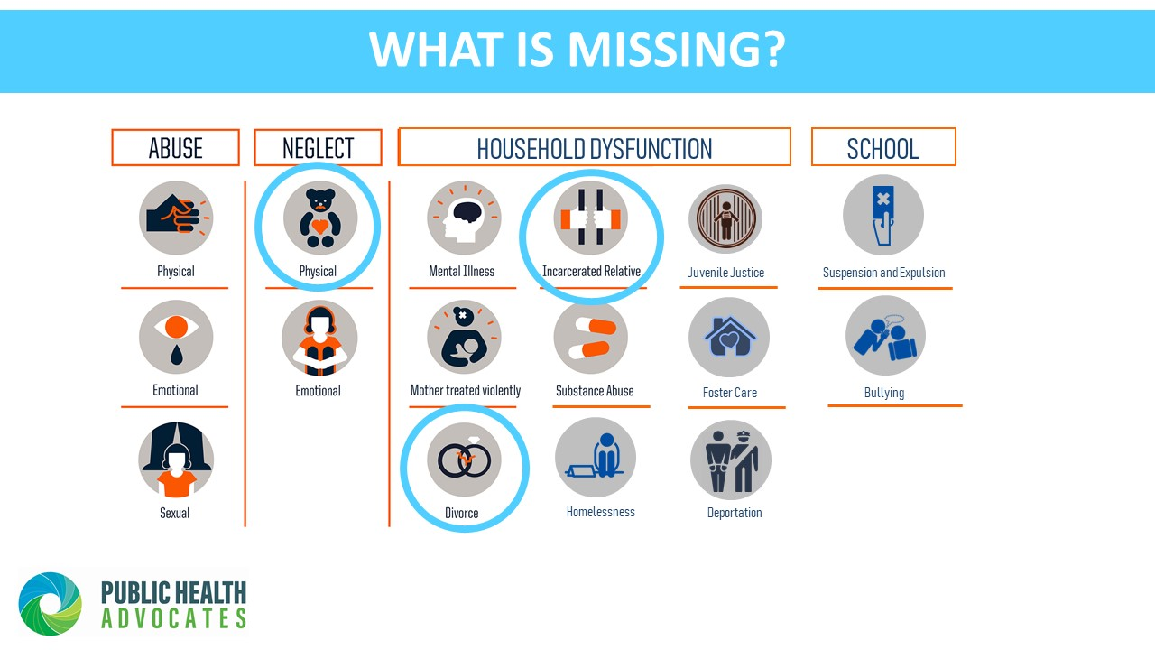

Slide 10
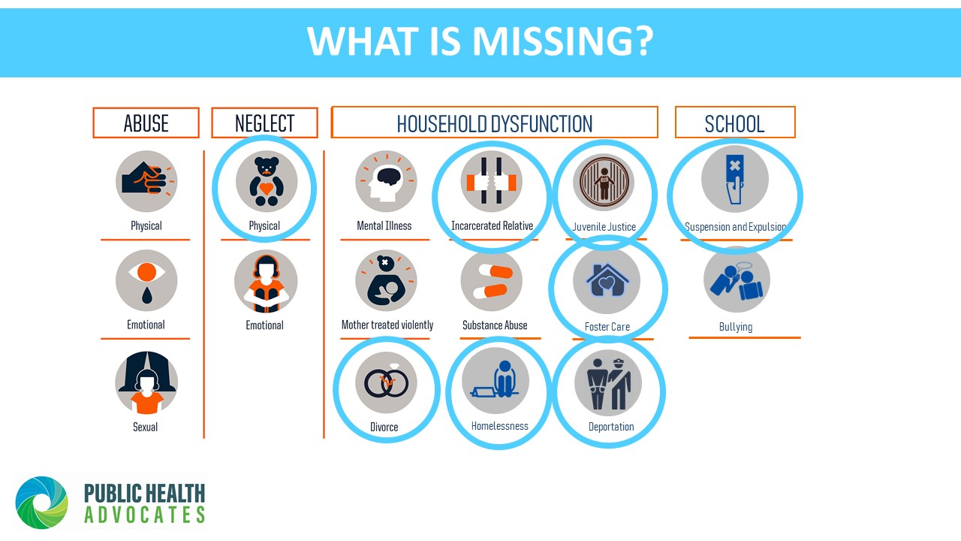

Slide 11
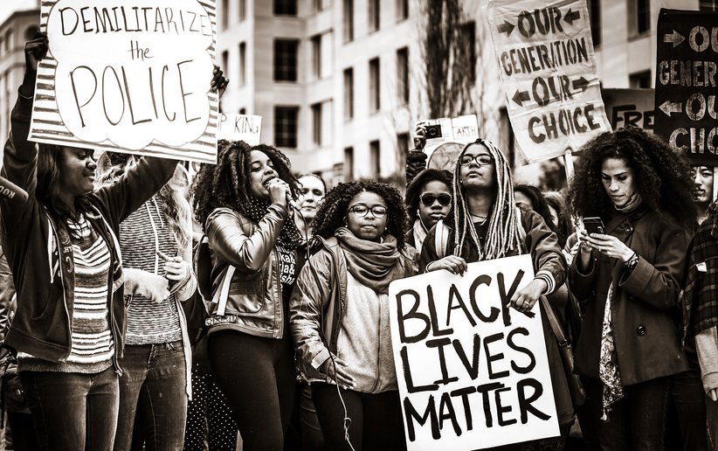
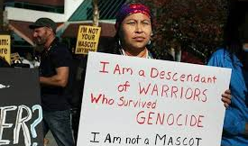
COMMUNITY TRAUMA
Natural Disasters
  Hurricanes/Tornadoes/Wildfires
Discriminatory Policies
  War on Drugs
  Proposed Changes to Public Charge
  Muslim & Latino Ban
  Family Separation
Vilification of Identity
  White supremacy and “Othering”
  Muslim = Terrorist
  Black = Thug
  Latinx = Undocumented
  Native = Savage
Community Violence
  Shootings
  Sexual Assault
  Refugee Asylum
  Increase Law & Immigration Enforcement Presence
Concentrated Poverty
  Neighborhood appearance
  Police Presence

Slide 12

Community Trauma
Adverse
CHILDHOOD
Experiences
Adverse
COMMUNITY
Experiences
Notes:
Timing: abuse, neglect and household dysfunction before age 18
The Story:
Accidental finding in obesity clinic with patients of size
Duplicated in 17,000 Kaiser Patients
Perceived low risk: mostly white, college educated, and insured by employer
Since 1997 over 200 publications on short and long-term outcomes

Slide 13
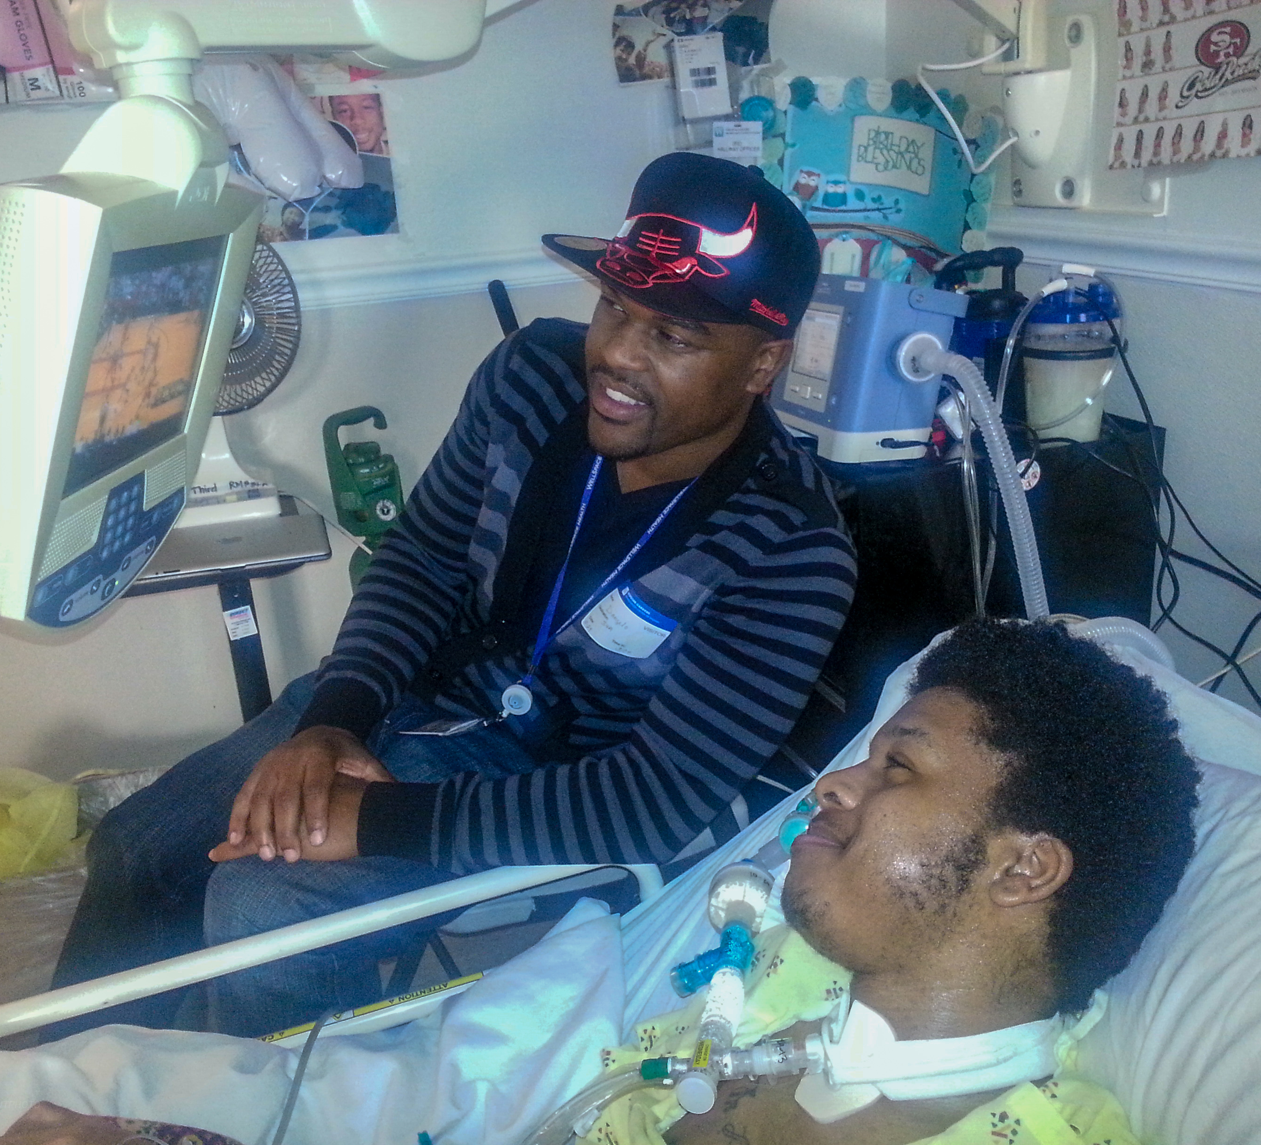
ADVERSE COMMUNITY
EXPERIENCES
Notes:
Timing: abuse, neglect and household dysfunction before age 18
The Story:
Accidental finding in obesity clinic with patients of size
Duplicated in 17,000 Kaiser Patients
Perceived low risk: mostly white, college educated, and insured by employer
Since 1997 over 200 publications on short and long-term outcomes

Slide 14
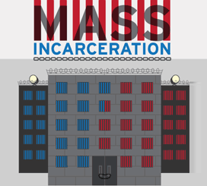
IMPACT OF THE WAR ON DRUGS IN CALIFORNIA
Community trauma
  Incarceration and family separation
Felony convictions jeopardized
  Immigration Status
  Child custody
  Employment
  Housing
  Social services
Sources:
National Center on Addiction & Substance Abuse. Behind Bars II: Substance Abuse and America’s Prison Population (2010).
American Civil Liberties Union. The War on Marijuana in Black and White: Billions of Dollars Wasted on Racially Biased Arrests (June 2013).

Slide 15

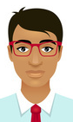
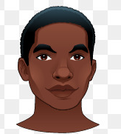
THE IMPACT IN NUMBERS
CA Arrests for Marijuana
Simple Possession
Sources:
  Differences ENTIRELY attributable to racial bias
MISDEMEANORS
FELONIES
45% ↑
100% ↑
26% ↑
500% ↑
Sources: Paul Guerino, Paige M. Harrison & William J. Sabol, U.S, Department of Justice, Bureau of Justice Statistics, Prisoners In 2010 (Dec. 2011).
Drug Policy Alliance & ACLU-CA. Marijuana Enforcement Disparities in California: A Racial Injustice (May 2016).
Katherine Beckett. ACLU Drug Law Reform Project & The Defender Association. Race and Drug Law Enforcement in Seattle (2008).
Ojmarrh Mitchell & Michael S. Caudy. Examining Racial Disparities in Drug Arrests. Justice Quarterly (2013).
Drug Policy Alliance. It’s Not Legal Yet: Nearly 500,000 Californians Arrested for Marijuana in Last Decade (August 2016).

Slide 16
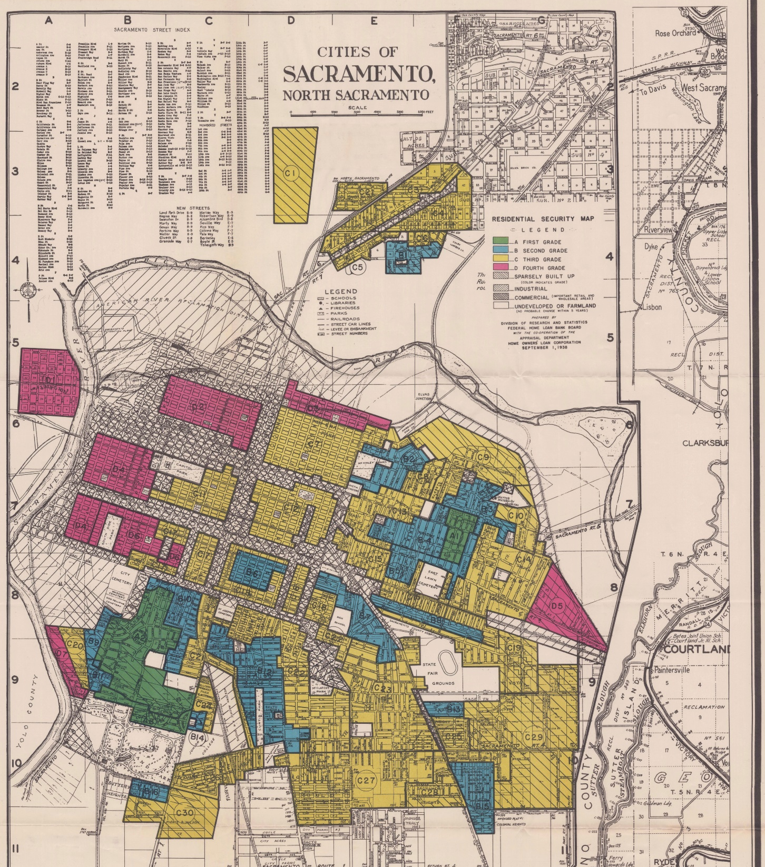
REDLINING: An Example of Institutional Racism
Official Practice 1934-1968
Grades that FHA gave to neighborhoods
  Green (A) - “best”
  Blue (B) - “still desirable”
  Yellow (C) - “definitely declining”
  Red (D) for “hazardous”
System based on white supremacy and proximity to blackness
Source: https://www.theatlantic.com/business/archive/2014/05/the-racist-housing-policy-that-made-your-neighborhood/371439/

Slide 17
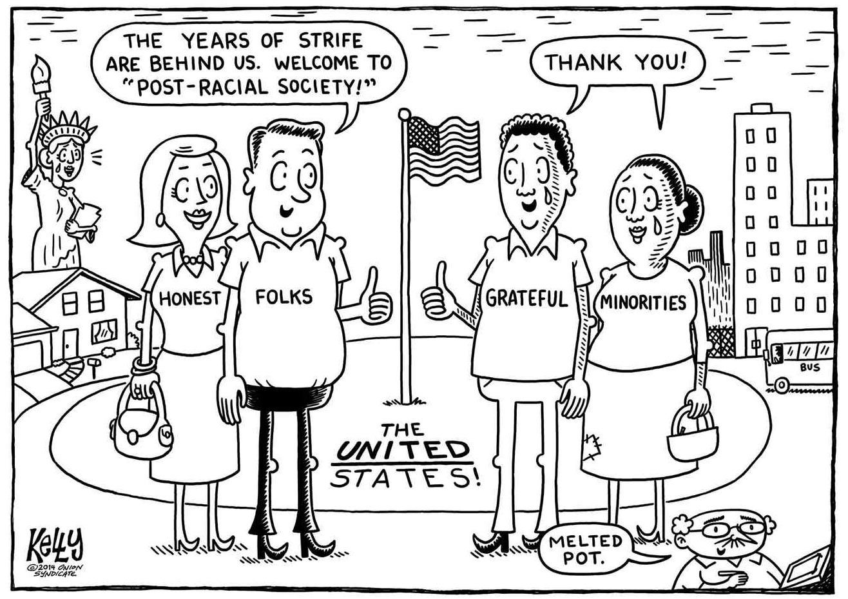
THE LEGACY OF REDLINING
Fifty Years later in 2018…
2/3 of D areas are inhabited by mostly Black and Latinos
3/4 of D areas continue to struggle economically
91% of A areas remain middle-to-upper-income today
85% of A areas still predominantly white
Source: https://www.washingtonpost.com/news/wonk/wp/2018/03/28/redlining-was-banned-50-years-ago-its-still-hurting-minorities-today/?utm_term=.643dd676fb9a

Slide 18
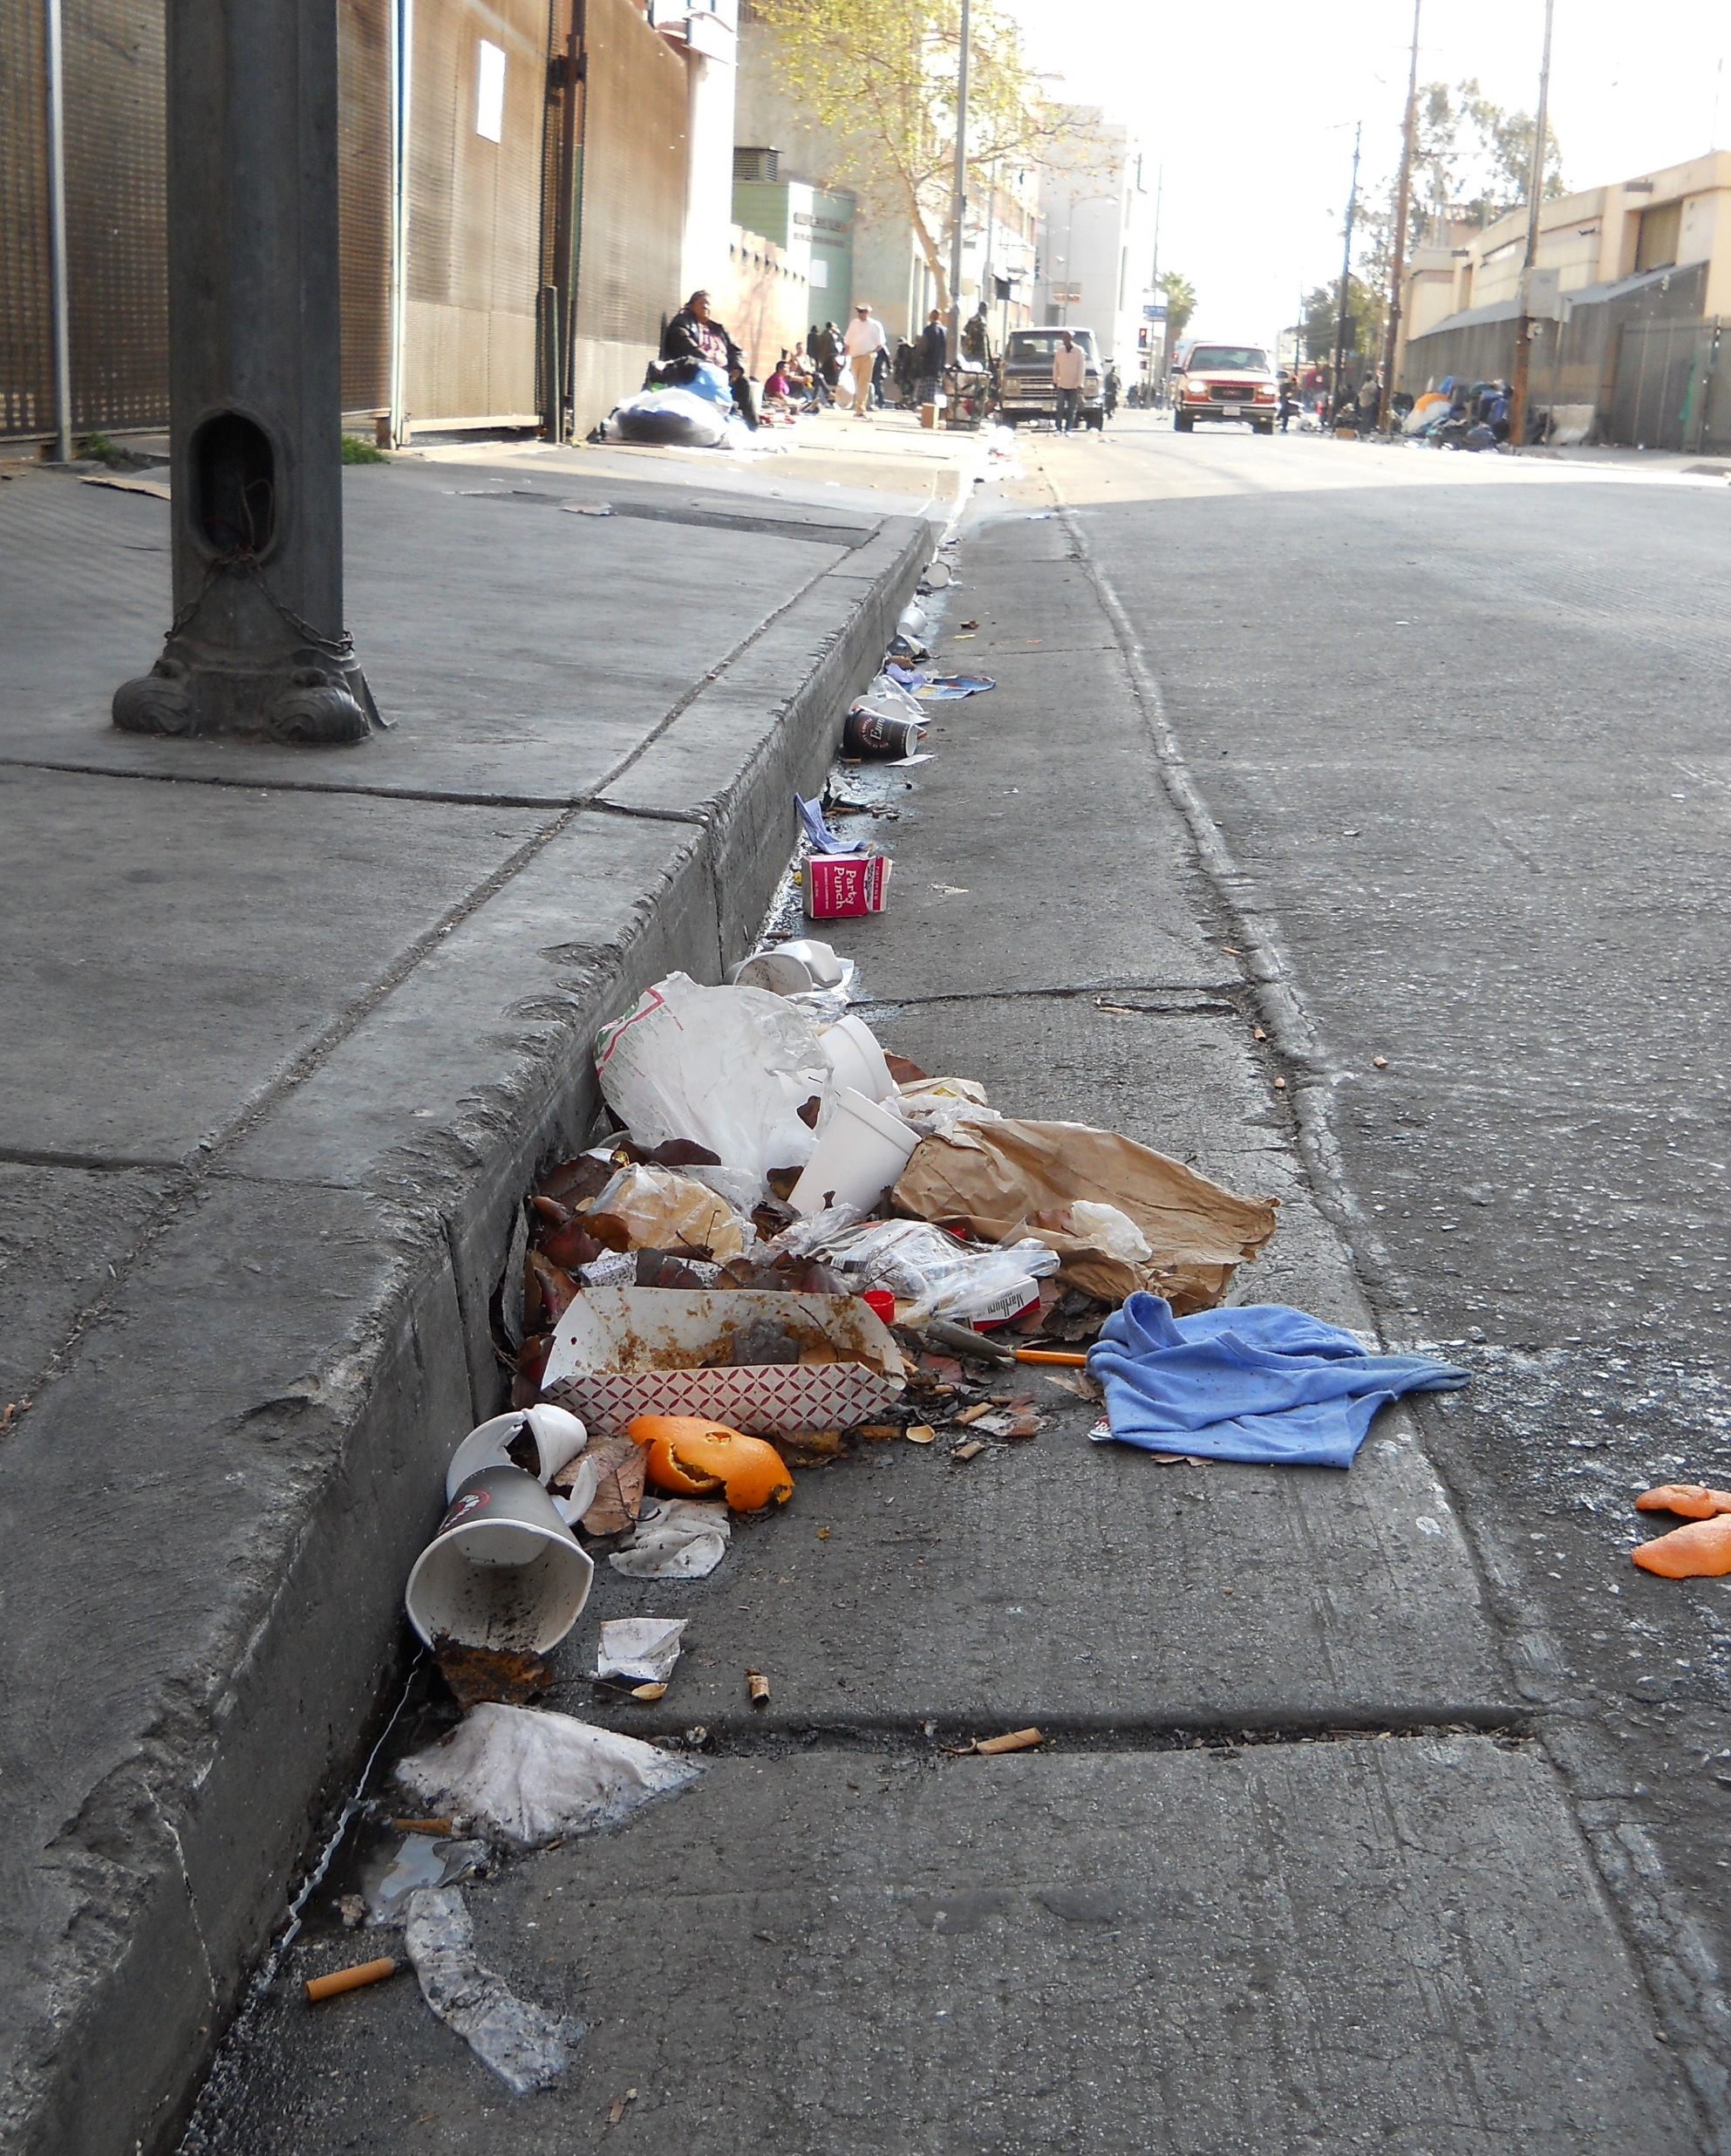
THE IMPACT
Expected Disproportionality
Poor/underperforming schools
Poorly maintained areas
Food deserts
Community violence
High incarceration rates
Higher disease burden
Lower life expectancy

Slide 19

Interacting Layers of Trauma and Healing
Dehumanization and Distress
Liberation and Healing
Nation Building by Enslavement, Genocide, Colonization, Economic Exploitation, Resource Extraction, White Supremacy, Patriarchy…
Systemic Subjugation of BIPOC by Interacting Policies & Systems: (Capitalism): Broken Treaties, War on Drugs, Mass Incarceration, Criminalization of Poverty & Survival, Anti-Immigrant/Imperialist Policies, Redlining and Gentrification, Climate Violence, Media Assaults…
Atmospheric Distress that includes Interpersonal, Family, Community Violence & Exposure; Sexual Exploitation/Gender Violence, Displacement, Lack of Safe Passage and Spaces; Lack of Green Spaces, Underinvestment, Oversurveillance…
Embodiment and Expression of Distress through Personal Traumatic Experiences; Bullying/Gender Violence, Family Systems Stressors, ACEs, Shame and Blame, Generational Transmission…
History, Legacy & Structure
Collective Liberation by Truth & Reconciliation, Reparations, Redistribution, Open Borders/No Borders, Multi-racial Solidarity, Gender Justice, Just Transitions…
Lead with Love and Justice by Healing-Centered & Restorative Practices, Listening Campaigns, Collective Care, Identity Affirming, Adaptive, Responsive, and Proximate, Land and Power-sharing (Nothing about us without us)…
Build Beloved Community by Radical Inquiry, Popular Education and Culture Building, Celebration and Affirmation; Healing Spaces, Land Acknowledgement, Arts & Expression, Base & Power-Building…
Honor Resilience and Fortitude by Listening & Validating, Processing/Integrating Personal Traumatic Experiences, Family Healing, Tailored Supports & Opportunities, Loving Connections To Each Other and The Land; Loving, Predictable Structure…
Systems & Institutions
Community & Place
Individual & Interpersonal
RYSE, 2019

Slide 20
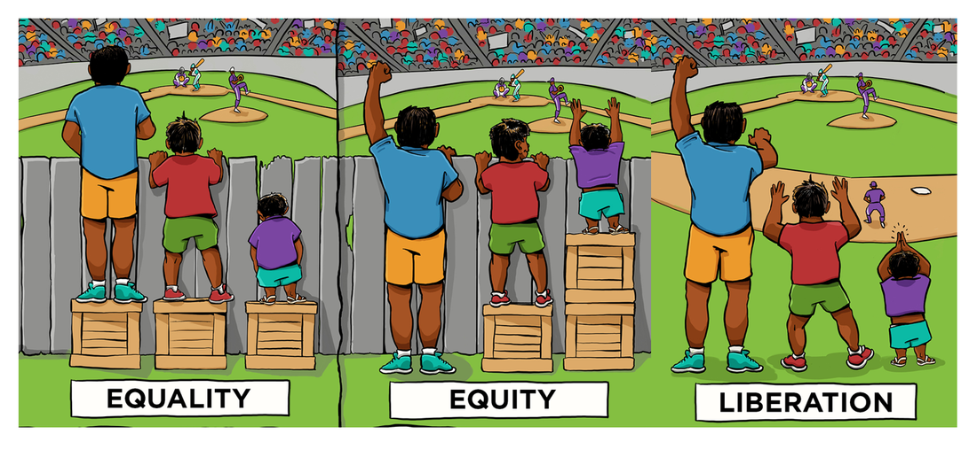
CULTURALLY RESPONSIVE & HEALING
#ACEsCon2018

Slide 21
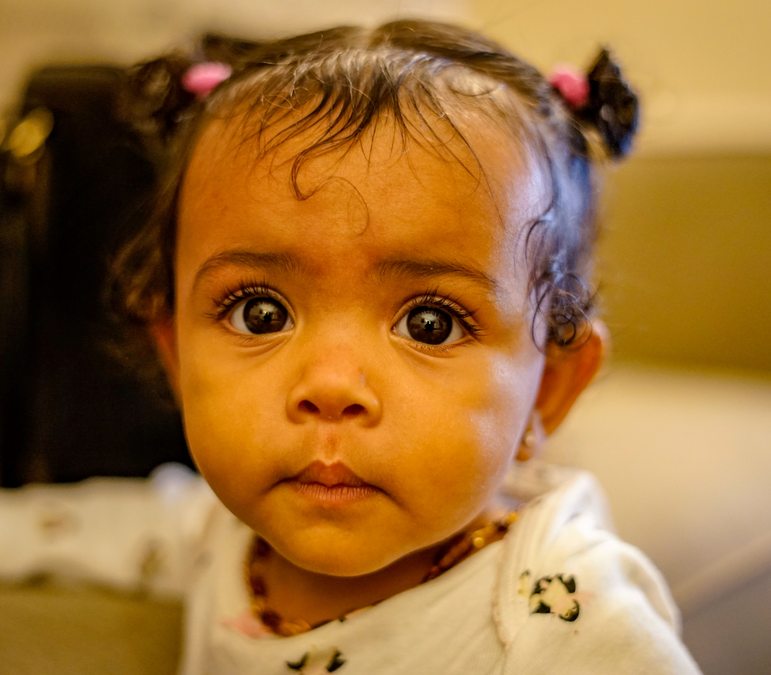
EMPATHY (Re-SPECT)

Slide 22
dm@phadvocates.org
Thank You!!!
DeAngelo Mack
Director of State Policy

